Slide 1
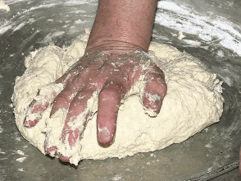
Dough
By Şamil Korkmaz - Own work, Public Domain, https://commons.wikimedia.org/w/index.php?curid=36922100

Slide 2
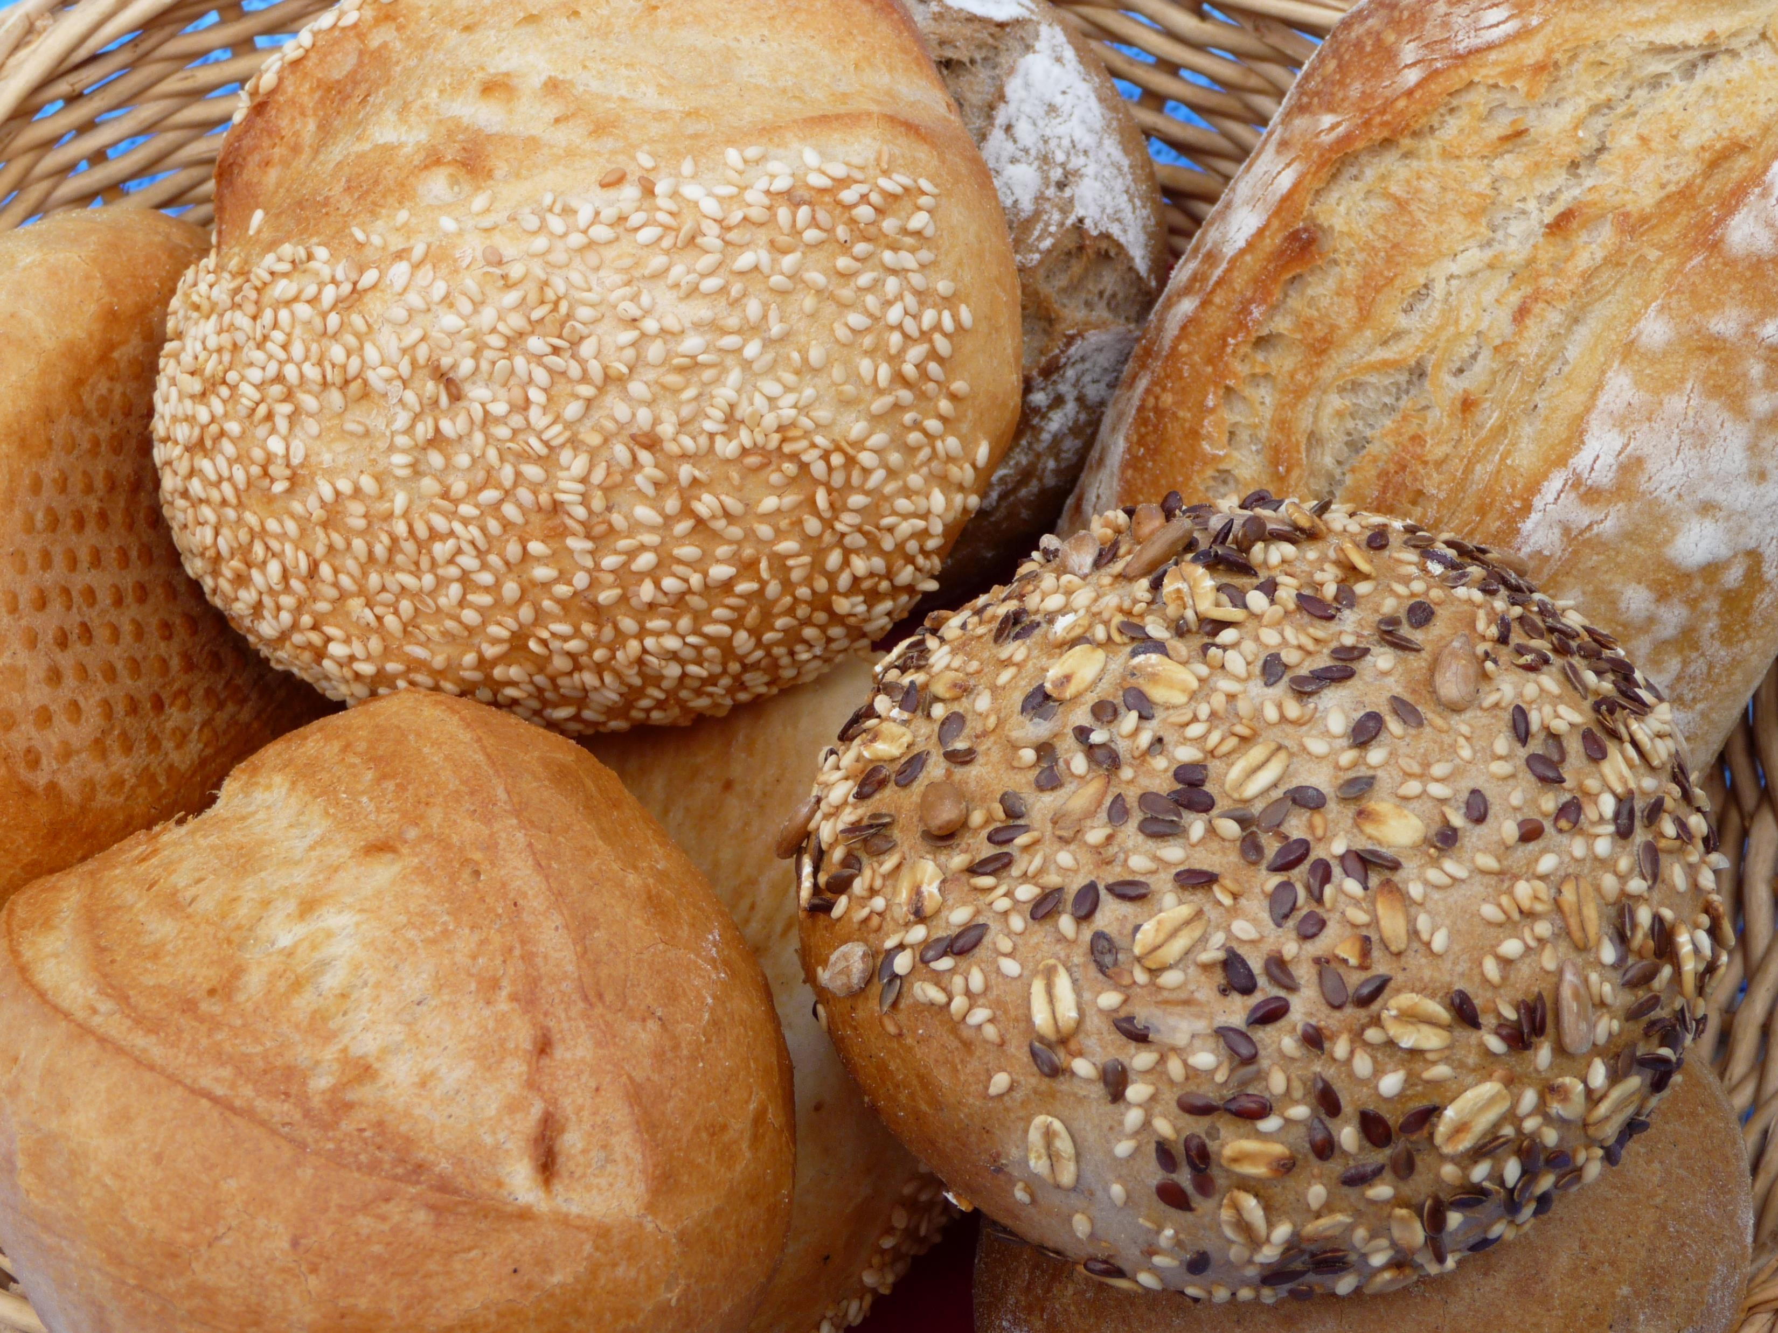
Dough (class)
Things Created from Dough (object)
Spaghetti (object)
Doughnut (object)
Pastry etc.
The dough cannot be consumed in its form, it needs to be converted (instantiated) through processing (heating, etc) into a consumable product.
By 3268zauber - Own work, CC BY-SA 3.0, https://commons.wikimedia.org/w/index.php?curid=4298187

Slide 3
Dough (class)
When the dough is finally processed into a consumable product you can
- eat, transport, sell, package, etc. The final product becomes “A ready to eat on spot commodity”.

Slide 4
Comparison
Dough (class) | Processed Dough (Created or instantiated) (object)
Raw, none consumable | Ready to Eat, finished
Used to create different pastry from composition | Single pastry finally made e.g bread or doughnut
Has a specific texture (solid) | Texture based on what was created
Color – specific | Color – vary
Texture | Texture
To convert from Dough to Bread….you have to BAKE! (INSTANTIATE)

Slide 5
Objects and Classes in Python
Introduction to Objects and Classes in Python

Slide 6
Objects and Classes
You need a class to create an object.
A class describes how to create something.
An object is the actual thing created from a class

Slide 7
What is an Object
An object is created from a design instruction called classes. This instruction provides the format needed to create a variable. It could be an int, a dictionary, a set, or any other type in Python.

Slide 8
What is an object
An object is a thing that has characteristics and can do something.
A phone object can have a ‘color’ characteristics described by blue
While a phone can have an action (behavior) called ‘Calling’

Slide 9
What is a class
A class is an instruction, rules, description, or template required to create an object.
You cannot eat scrambled eggs by reading the step-by-step instructions in a cookbook. (class)
But you can eat the scrambled eggs you made in the real world after reading the instructions, cooking the eggs and adding all the necessary ingredients.
At this point the scrambled eggs are now an instance (real thing or object) of the cookbook class!

Slide 10
How python prepares a class
- special method called __init__().
This method is automatically built into all classes in python.
To make the object to be created aware of itself a special parameter called self is used in the __init__(self) method.
Note: you don’t have to use the ‘self’ keyword, but it’s a good old tradition to use it.

Slide 11
How classes and objects work in Python
Whenever you create an object from a class in python, the program will search for an __init__() method and uses it to properly assign whatever things you want the object to have when it is eventually created (instantiated).
So self and functions work harmoniously.
Whenever you see self in a function, it lets you know that that object will be self-aware of itself.
The keyword self will make sure it binds an object to its functions and properties.

Slide 12
Dunder (Double Underscore) Methods
__str__
__init__
__file__
__import__
__loader__
__name__
Special methods used for overloading (changing default behavior)

Slide 13
OOP Paradigm
Abstraction (showing or exposing only what is necessary)
Len() method from str class – get the sum of characters in a string
We just need it to return the length e.g name = ‘hello’
Len(name) will return 4 because there are four letters in the variable called name.

Slide 14
OOP Paradigm
Encapsulation
Parts of a program working independently from each other.
Prevents unauthorized access and adds levels of organization and security

Slide 15
OOP Paradigm
Inheritance
Creating a hierarchy structure in a program that allows derivatives to borrow from other objects without needing to write the whole class from scratch.
A new class could derive, borrow or override functions from a main class (Parent or Super class)

Slide 16
OOP Paradigm
Polymorphism
Existing in different forms e.g Shape Class can have Circle and Square which share an Area Method. The Area method will be different for the Circle and Square.
Polymorphism means changing an inherited behaviour.

